Slide 1
Protocol Development
Presenting:

Slide 2
This document is marked with a dated date and speaks only as of that dated date. Readers are cautioned not to assume that any information has been updated beyond the dated date except as to any portion of the document that expressly states that it constitutes an update concerning specific recent events occurring after the dated date of the document. Any information contained in the portion of the document indicated to concern recent events speaks only as of its date. TEXAS HEALTH RESOURCES (“THR”) expressly disclaims any duty to provide an update of any information contained in this document. The information contained in this document may include "forward looking statements" by using forward-looking words such as "may," "will," "should," "expects," "believes," "anticipates," "estimates," or others. You are cautioned that forward-looking statements are subject to a variety of uncertainties that could cause actual results to differ from the projected results. Those risks and uncertainties include general economic and business conditions, receipt of funding grants, and various other factors which are beyond our control. Because we cannot predict all factors that may affect future decisions, actions, events, or financial circumstances, what actually happens may be different from what THR includes in forward-looking statements. Information contained in the presentation is confidential and proprietary and its use is expressly limited to the S&P Global Ratings’ update presentation.
INFORMATION CONTAINED IN THE PRESENTATION CAN NOT BE USED OR DISTRIBUTED TO ANY THIRD PARTY OR USED IN ANY REPORT WITHOUT THE WRITTEN CONSENT OF TEXAS HEALTH RESOURCES.

Slide 3
Protocol Development
What is a protocol?
  The protocol is a study plan, or an investigational plan, which describes how the clinical research study will be implemented. It should be written in a comprehensive manner to leave no room for misinterpretation.
  For Investigator initiated research, templates and other helpful information can be found in the UTSW page at: https://www.utsouthwestern.edu/research/hrpp/forms/#protocol

Slide 4
Protocol Development
A protocol is designed as an instruction manual on how to answer a specific research question, while protecting the rights, safety, and welfare of subjects.
The protocol must include specific information about who may participate in the study, how many subjects will be studied, the primary measures to be evaluated, and the schedule of tests, procedures, medications, and dosages as applicable.
The protocol should include the length of study participation, potential risks, and how adverse events will be handled.
The protocol allows researchers at multiple locations (multi-site study) to perform the study in the same manner so that their data can be combined as though all data was obtained at the same study site.

Slide 5
Protocol Development
The protocol is at the center of any clinical trial. It details all the information required to safely conduct the study.
A protocol may come from a sponsor, such as a drug company, or it may be developed by an individual investigator.
Protocol formats can vary between companies and investigators, but the content should not.
There are some sections in the protocol that may not be included, depending on the discipline being studied, as well as the phase of study.
Not all study staff are involved in writing the protocol, but all members of the team should understand the necessary protocol components.

Slide 6
Protocol Components
A general protocol includes the following contents:
Title of the study
Administrative details
Project summary
Introduction to the research topic, background (Literature review)
Preliminary studies
Study objectives and/or questions. Statement of the problem.
Methodology: Study design, study population, and methods of recruitment, variables list, sample size, methods of data collection, data collection tools, plan of analysis (analysis of data)
Project management: Work plan (Timeline – proposed schedule)
Strengths and limitations of the study
Issues for ethical review and approvals

Slide 7
Protocol Components
However, according to the ICH Good Clinical Practice guidelines, a protocol should include the following topics as below:
Title page (General Information)
Background Information
Objectives/Purpose
Study design
Selection and exclusion of subjects
Treatment of subjects
Assessment of efficacy
Assessment of safety
Adverse events
Discontinuation of the study
Statistics
Quality control and assurance
Ethics
Data handling and recordkeeping
Publication Policy
Project timetable/flowchart
References
Supplements/appendices

Slide 8
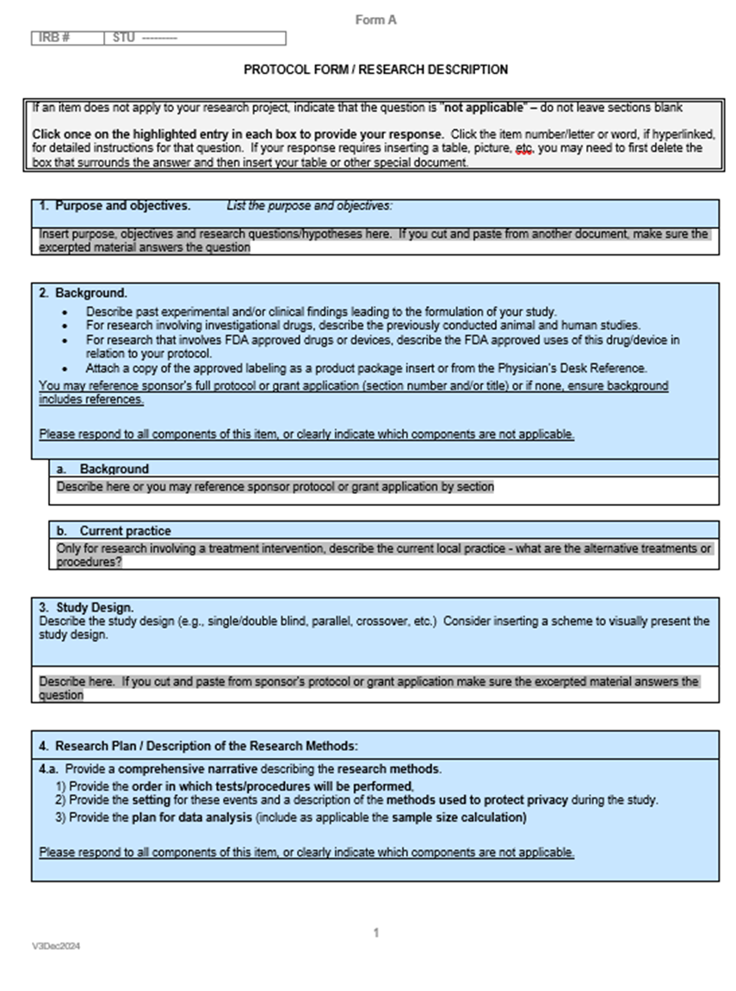
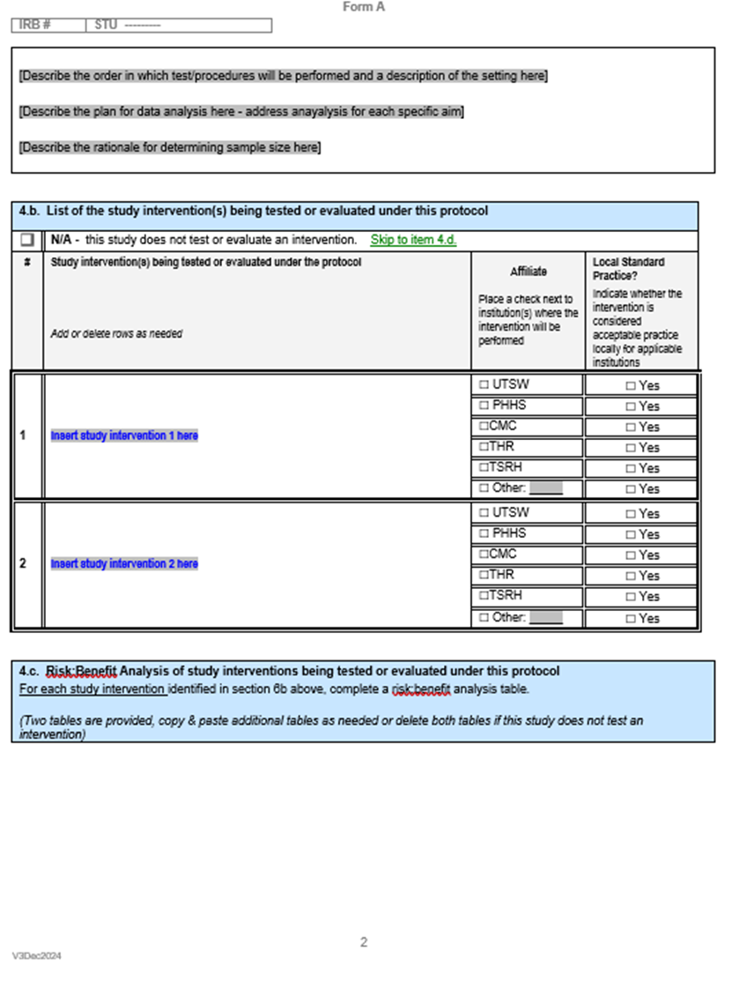
Protocol Template example UTSW

Slide 9
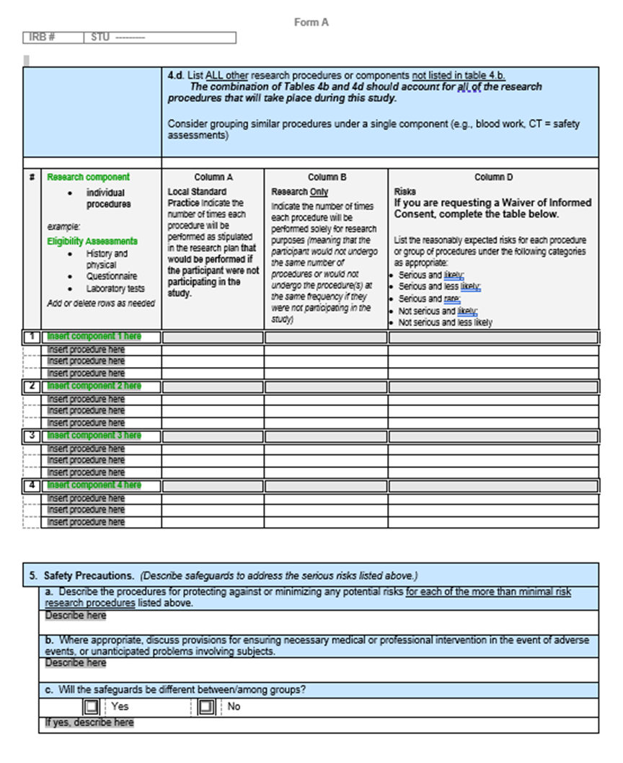
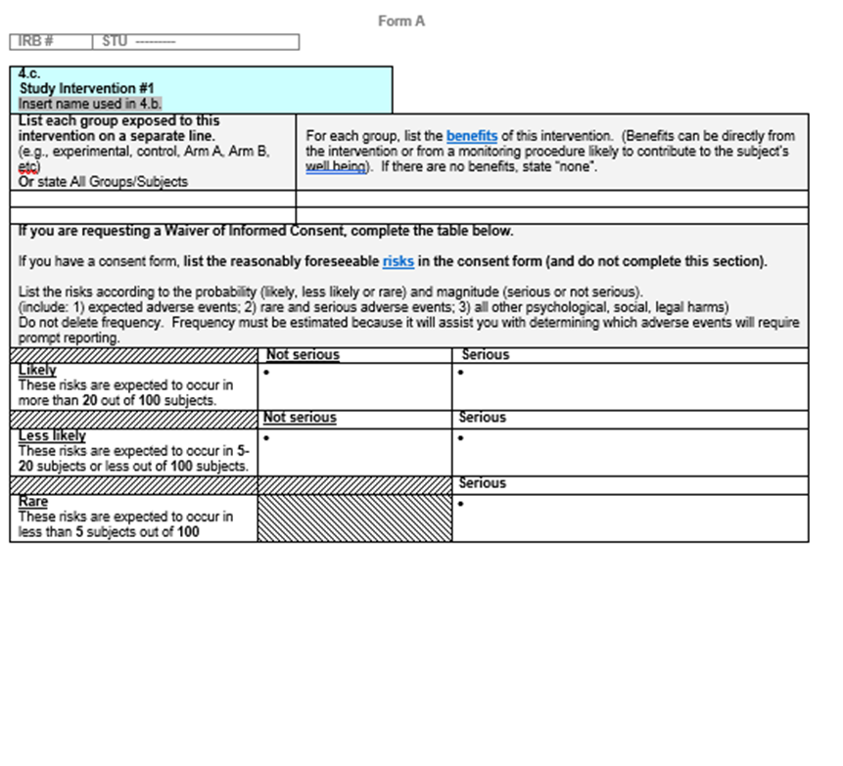
Protocol Template example UTSW con’t.

Slide 10
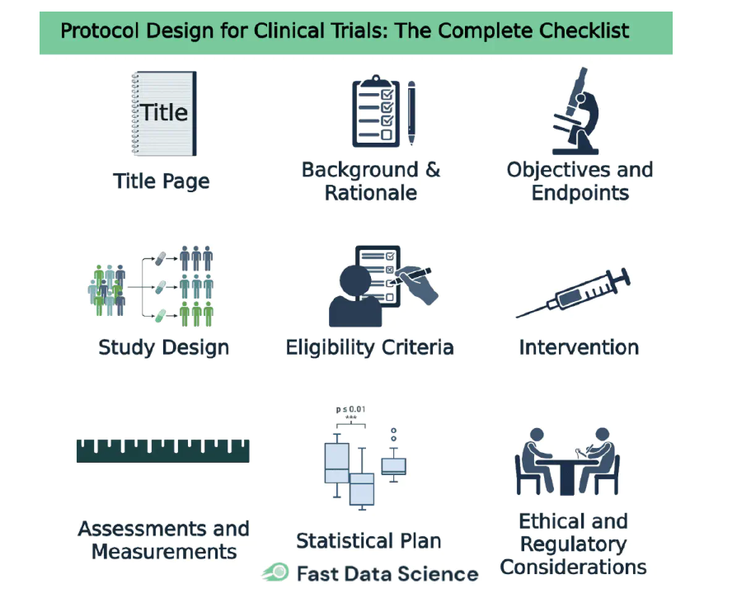
Protocol Checklist

Slide 11
Resources
To Access the THRE Webpage for more information on clinical research visit https://www.texashealth.org/research.
https://www.utsouthwestern.edu/edumedia/edufiles/research/research_administration/irb/protocol-guidance-eirb.pdf
https://clinicaltrialrisk.org/clinical-trial-design/protocol-design-for-clinical-trials-the-complete-checklist/
UTSW Protocol Templates: https://www.utsouthwestern.edu/research/hrpp/forms/#protocol
UTSW CLINICAL RESEARCH HANDBOOK

